Slide 1

SMART
PARKING SLOT AVAILABILITY AND ENTRY
CONTROL SYSTEM

Slide 2

INTRODUCTION: MODULE 1 → OUR PROJECT PARK-LOGIC
SMART PARKING SLOT AVAILABILITY& ENTRY CONTROL SYSTEM
MODULE 1 CONNECTION:
COMPUTERS PROCESS INFORMATION USING DIGITAL SIGNALS (0 AND 1).
REAL-WORLD PROBLEMS CAN BE CONVERTED INTO DIGITAL LOGIC.
OUR PROJECT APPLIES THIS IDEA TO A PARKING SYSTEM
REAL-WORLD PROBLEM→ DIGITAL INPUTS→ LOGIC GATES
→OUTPUT
OUR GOAL: DETERMINE WHETHER A PARKING SLOT IS AVAILABLE ANDGENERATE AN IMMEDIATE ENTRY DECISION.

Slide 3
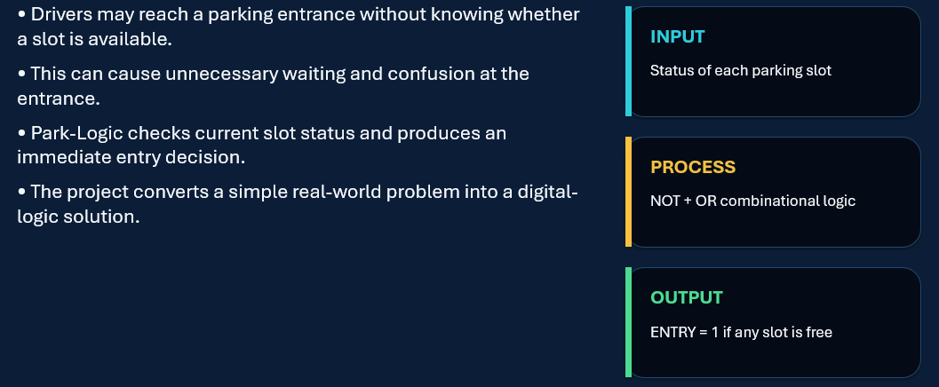
PROBLEM STATEMENT
.

Slide 4


D I GI T AL RE PR ES E N T A T I O N & I N P UT S
H OW P A RK I NG B E C O M ES D I G I T A L?
E A C H P A R K I N G S L O T I S R E P R E S E N T E D B Y A D I G I T A L I N P U T :
0 = F R E E
1 = O C C U P I E D
I N P U T S : S 1 , S 2 , S 3 , S 4
E X A M P L E :
S 1 S 2 S 3 S 4
0 1 1 0
S 1 A N D S 4 A R E F R E E
P A R K I N G I S A V A I L A B L E
M O D U L E 1 C O N C E P T :
C O M P U T E R S R E P R E S E N T I N F O R M A T I O N U S I N G T W O S T A T E S : 0 A N D 1 .

Slide 5

LOGIC GATES BOOLEAN EXPRESSION
~THE LOGIC BEHIND PARK-LOGIC
~Our circuit uses:
NOT gates + OR gate
~Boolean expression:
ENTRY = ¬S1 + ¬S2 + ¬S3 + ¬S4
NOT gate: Identifies a FREESLOT.
OR gate: Checks whether at least one slot is free.
ENTRY= 1 → Enter
ENTRY = 0 → Wait
~Module 1 Concepts:
LOGIC GATES , BOOLEAN OPERATIONS, COMBINATIONAL LOGIC

Slide 6

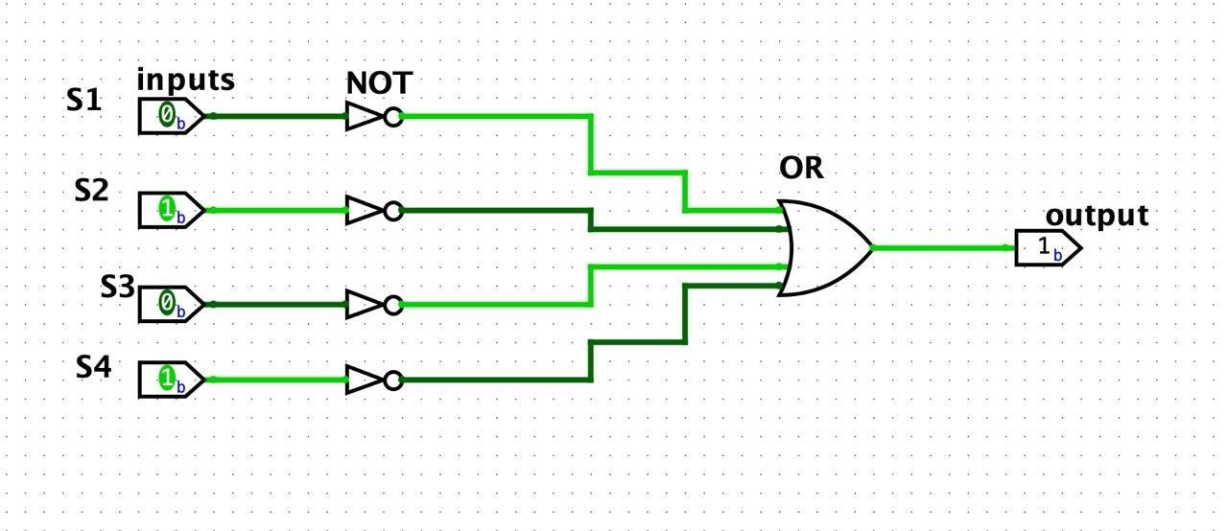
Truth Table → Circuit → Logisim
DESIRED BEHAVIOUR
TRUTH TABLE
BOOLEAN EXPRESSION
LOGIC GATES

Slide 7
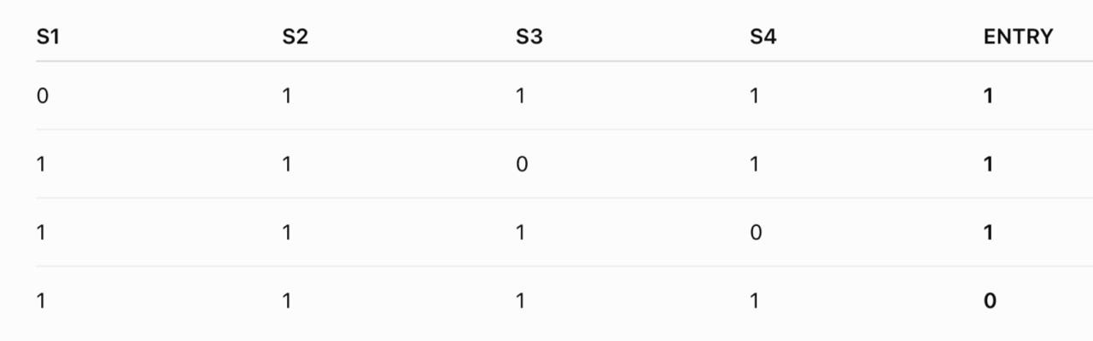
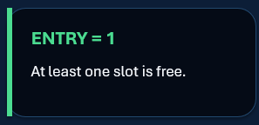
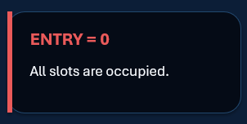
Truth Table → Circuit → Logisim
DESIRED BEHAVIOUR
TRUTH TABLE
TRUTH TABLE
BOOLEAN EXPRESSION
LOGIC GATES

Slide 8
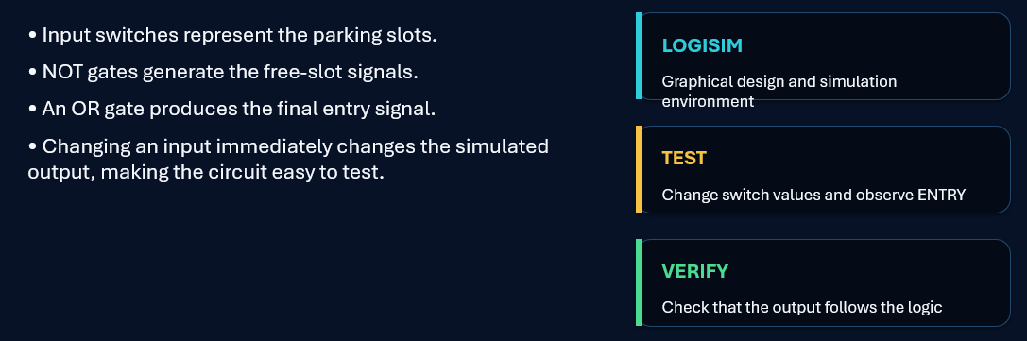
LOGISIM IMPLEMENTATION

Slide 9
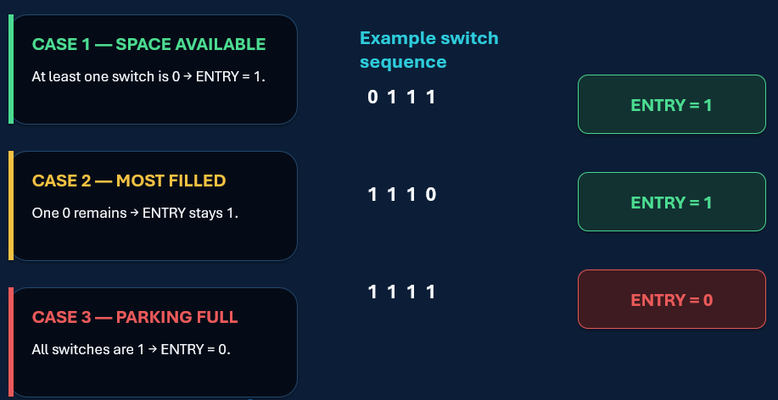
DEMO - TESTING

Slide 10


Result, Applications & Module 1 Connection
Module 1 Concepts Used:
Digital 0 & 1
Logic Gates
Boolean Logic
Truth Tables
Combinational Logic
Truth Table → Circuit
Logisim Simulation
Future Scope:
Automatic parking sensors
Digital display of available slots
Vehicle counting
Multiple parking zones
Automatic gate control
Project Result
FREE SLOT → ENTRY = 1 PARKING FULL → ENTRY = 0

Slide 11
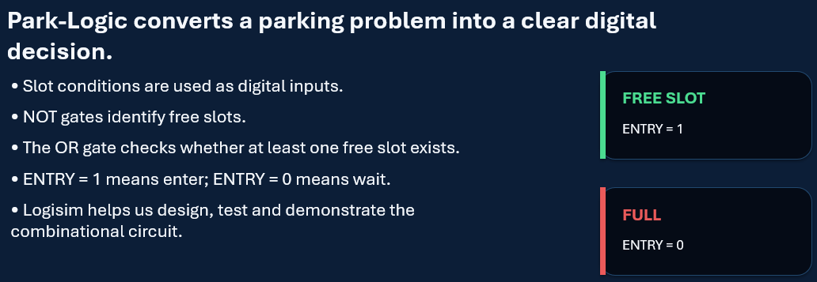
CONCLUSION

Slide 12


